Slide 1

Object-Oriented Programming and Data Abstraction Lesson 5: Inheritance
Sections 4.1 – 4.2
Notes:
Replace this with your course title and your name/contact details.

Slide 2
Interfaces – A look back

Slide 3
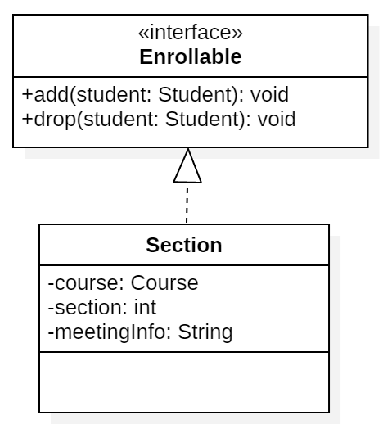
Interfaces were used to enforce behavior
Option 2
default concrete methods in interface; no methods in class
Previously, we talked about interfaces which could enforce certain behaviors in classes that implemented them through abstract methods.
But we also had default methods whose method body could be "inherited" by the implementing class.
We could make a Section, e.g., oopda01, and invoke the add() method.
oopda01.add(jacob);
Method Dispatch
When the Java runtime environment processes this call, it first looks to the class Section to see if it has the add() method. (It could have overridden the default)
Then it will look for an implementation of add() in the interface Enrollable.

Slide 4
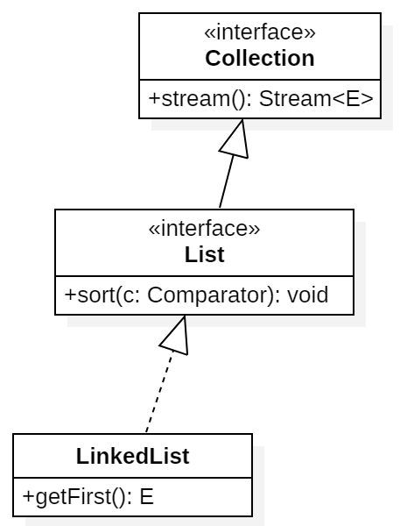
Interfaces could inherit
We have also seen Interfaces extending other interfaces.
In this case the interface List inherits the method stream() from the interface Collection
Now we are going to examine how classes can inherit from (extend) other classes.
extends
implements

Slide 5
Inheritance – Part 1 (from video lecture plus some supplemental slides)

Slide 6
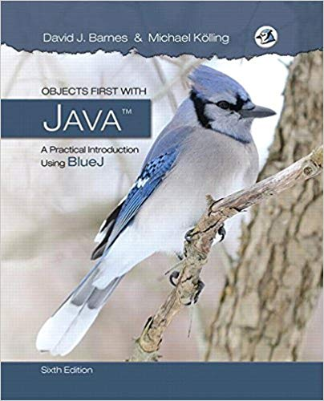
Acknowledgment
Examples and some source material extracted from:
Objects First with Java: A Practical Introduction Using BlueJ (6th Edition) 6th Edition
by David J. Barnes, Michael Kolling
Objects First with Java: A Practical Introduction is an introduction to object-oriented programming for beginners. The main focus of the book is general object-oriented and programming concepts from a software engineering perspective.

Slide 7

A Social Media Application
Imagine a social media application that stores two kinds of posts: simple message posts and photo posts

Slide 8
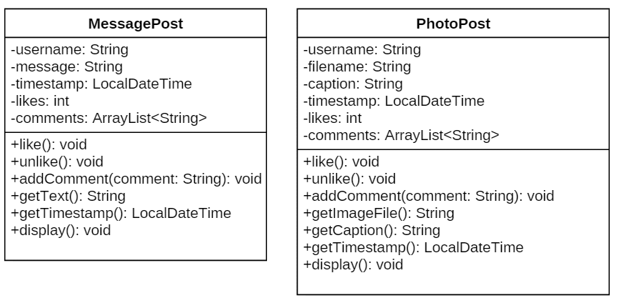
UML class diagram showing the two kinds of posts

Slide 9
Issues (1)
Do we really want to have code for instance variables for both types of posts that are practically identical? (duplicate code in MessagePost and PhotoPost)
Do we really want to code methods like display() in both MessagePost and PhotoPost? (duplicate code in MessagePost and PhotoPost)
Do we really want separate collections for each type of post? How would our Driver class (with the main method) work
How would we show the two kinds of posts? (duplicate code in Driver)
How would we add a post? (duplicate code in Driver)
Notes:
class diagram is simple (ArrayList not shown in BlueJ)

Slide 10
Issues (2)
Don't we want to interleave the MessagePosts and the PhotoPosts? Maybe in timestamp order?

Slide 11
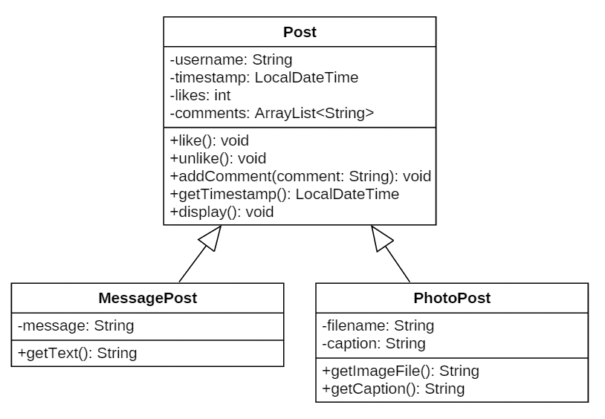
UML class diagram showing inheritance
define one superclass : Post
define subclasses for MessagePost and PhotoPost
the superclass defines common instance variables and methods
the subclasses inherit the superclass attributes (is-a relationship)
the subclasses add own instance variables and methods

Slide 12
Superclass and Subclasses
public class Post {
private String username;
private long timestamp;
private int likes;
private ArrayList<String> comments;
// constructor
public Post(String author) {
this.username = author;
this.timestamp = LocalDateTime.now();
this.likes = 0;
this.comments = new ArrayList<String>();
}.
}
public class MessagePost extends Post {
private String message;
// constructor
public MessagePost(String author, String text) {
super(author);
this.message = text;
}
}
public class PhotoPost extends Post {
private String filename;
private String caption;
// constructor
public PhotoPost(String author, String filename,
String caption) {
super(author);
this. filename = filename;
this.caption = caption;
} }
Notes:
we define common fields in superclass

Slide 13
Inheritance and Constructors and super()
Constructors are not inherited.
Subclass constructors must always contain a 'super' call
Must be the first statement in the subclass constructor.
A call to super() will be created in compilation even if the subclass doesn’t ask for it.
You can always invoke any method in the superclass by calling super.methodName(arguments)
Note: when invoking interface methods, you need to specify the interface Enrollable.super.add(student);
You do not need to include the name of the super class when calling one of its methods. A class only has one superclass.

Slide 14
Subclasss and Subtyping
First, we had:
public void addMessagePost (MessagePost message)
public void addPhotoPost (PhotoPost photo)
Now, we have:
public void addPost (Post post)
We call this method with:
MessagePost message = new MessagePost(...);
feed.addPost(message);
Classes define types.
A MessagePost is a type of MessagePost
Subclasses define subtypes.
A MessagePost is a subtype of Post
Objects of subclasses can be used where objects of supertypes are required. (This is called substitution .)
a MessagePost is-a Post

Slide 15
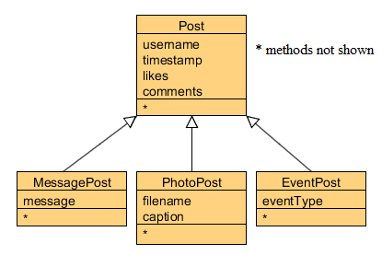
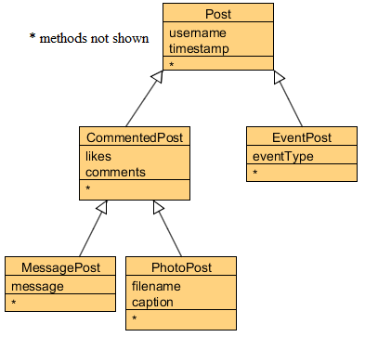

Adding more post types
Extensible!
Do you like this suggested change?
Notes:
it is now much easier to add new types.
common attributes do not need to be rewritten.

Slide 16
New NewsFeed source code
public class NewsFeed {
private ArrayList<Post> posts;
/**
* Construct an empty news feed.
*/
public NewsFeed() {
posts = new ArrayList<Post>();
}
/**
* Add a post to the news feed.
*/
public void addPost(Post post) {
posts.add(post);
}
...
}
only one collection
avoids code duplication in client!
…but….we don't want to add Posts, we want to add MessagePosts and PhotoPosts!
Notes:
note: code duplication in class NewsFeed removed as well!
only on field, one ArrayList creation, on add method

Slide 17
New NewsFeed source code
/**
* Print the news feed details to
* the terminal.
*/
public void show()
{
for(Post post : posts) {
post.display();
// Print an empty line between items
System.out.println();
}
}
}
…but….we don't want to display Posts, we want to display MessagePosts and PhotoPosts!
Notes:
...and only one loop in list method.

Slide 18
Subclasss and Subtyping
First, we had:
public void addMessagePost (MessagePost message)
public void addPhotoPost (PhotoPost photo)
Now, we have:
public void addPost (Post post)
We call this method with:
MessagePost message = new MessagePost(...);
feed.addPost(message);
Classes define types.
A MessagePost is a type of MessagePost
Subclasses define subtypes.
A MessagePost is a subtype of Post
Objects of subclasses can be used where objects of supertypes are required. (This is called substitution .)
a MessagePost is-a Post

Slide 19
Inheritance – Part 1 (for discussion in-class)

Slide 20
Subclasss and Subtyping
First, we had:
public void addMessagePost (MessagePost message)
public void addPhotoPost (PhotoPost photo)
Now, we have:
public void addPost (Post post)
We call this method with:
MessagePost message = new MessagePost(...);
feed.addPost(message);
Classes define types.
A MessagePost is a type of MessagePost
Subclasses define subtypes.
A MessagePost is a subtype of Post
Objects of subclasses can be used where objects of supertypes are required. (This is called substitution .)
a MessagePost is-a Post

Slide 21
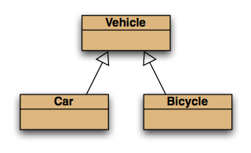
Subtyping and assignment
subclass objects may be assigned to superclass variables
Vehicle v1 = new Vehicle();
Vehicle v2 = new Car();
Vehicle v3 = new Bicycle();
Error if:
Car c1 = new Vehicle();
Car c2 = new Bicycle();

Slide 22
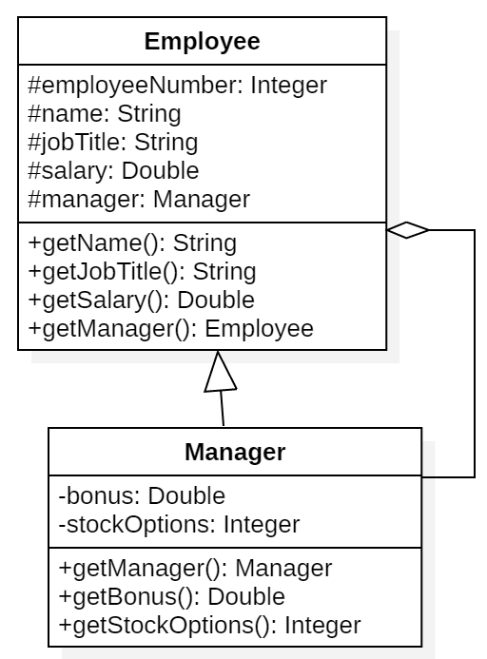


Overriding Superclass Methods with Covariant Return Types
As we learned when using interfaces, to override a method, the replacement method must have the same method signature and the return type must be "covariant".
Covariant means that the return type must be of the same type or a more specific type.
Example, Manager is a subclass of Employee, but when an instance of Employee invokes getManager(), an Employee object is returned.
But when and instance of Manager invokes getManager(), a Manager object is returned. public Employee getManager() { // Don't return a sensitive Manager object // but an Employee representation with less // attributes return new Employee(this.manager);
}
@Override
public Manager getManager() {
return this.manager;
}

Slide 23
Preventing a Method from Being Overridden
The final modifier will prevent the overriding of a superclass method in a subclass.
public final void message()
If a subclass attempts to override a final method, the compiler generates an error.
This ensures that a particular superclass method is used by subclasses rather than a modified version of it.

Slide 24

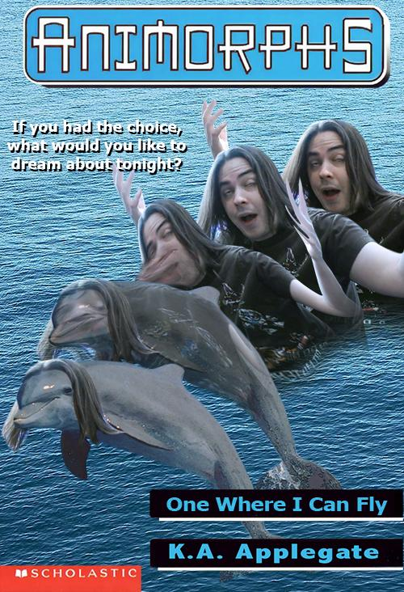

Polymorphism

Slide 25
Inheritance – Part 2 (from video lecture plus some supplemental slides)

Slide 26
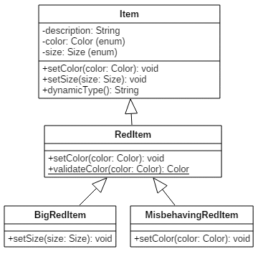
Item Example
Item class
Has two enum definitions: one for Color and one for Size
Very standard setter, which takes an enum value for Color and sets Item's instance variable.
RedItem class
Has a static method called validateColor() to make sure that a RedItem is in fact red.
Setter and Constructor call validateColor()
public static Color validateColor(Color color) {
if (color.equals(Color.CRIMSON) ||
color.equals(Color.RED) ||
color.equals(Color.MAROON) ||
color.equals(Color.TOMATO)) {
return color;
}
else {
return Color.RED;
}}
Not all methods shown in UML Class Diagram h

Slide 27
ArrayList<Item>
A polymorphic collection of Items
We will loop through Items but we will find Items, RedItems, BigRedItems…
ArrayList<Item> items = new ArrayList<Item>();
items.add(new Item("generic item", Color.BEIGE, Size.SMALL));
items.add(new RedItem("strawberry", Color.CRIMSON, Size.SMALL));
items.add(new BigRedItem("firetruck", Color.RED));
items.add(new MisbehavingRedItem("lime", Color.LIMEGREEN, Size.SMALL));
items
ArrayList<Item>
0
1
2
3
Item
generic item
RedItem
strawberry
BigRedItem
firetruck
MisbehavingRedItem
lime

Slide 28
Variables
A polymorphic variable
The static type of i is Item
The dynamic type of i is Item, RedItem, BigRedItem… whatever is really stored in memory.
ArrayList<Item> items = new ArrayList<Item>()
for (Item i : items) { System.out.println(i + " " + i.getClass().getSimpleName());
}
items.forEach(i -> System.out.println(i + " " + i.getClass().getSimpleName()));
Output
A SMALL, BEIGE generic item Item
A SMALL, CRIMSON strawberry RedItem
A LARGE, RED firetruck BigRedItem
A SMALL, LIMEGREEN lime MisbehavingRedItem
A polymorphic variable is a variable that can refer to different types of objects at different points in time.
items
ArrayList<Item>
0
1
2
3
Item
generic item
RedItem
strawberry
BigRedItem
firetruck
MisbehavingRedItem
lime

Slide 29
Methods
Polymorphic method dispatch
How the Java engine knows which method to use.
Always start at the dynamic type and work your way up the hierarchy.
items.forEach(i -> {
i.setColor(Color.ALICEBLUE);
i.setSize(Size.MEDIUM);
});
items
ArrayList<Item>
0
1
2
3
Item
generic item
RedItem
strawberry
BigRedItem
firetruck
MisbehavingRedItem
lime

Slide 30
Identifying Dynamic Types
Instanceof is a keyword. It checks if an object reference is an instance of a type, and returns a boolean value.
Class.getName() returns the full name (package + class name) of the object, as a String.
Class.getSimpleName() returns only the class name as a String.
Item item2 = items.get(2);
System.out.println(item2 instanceof Item);
System.out.println(item2 instanceof RedItem);
System.out.println(item2 instanceof BigRedItem);
System.out.println(item2.getClass().getName());
System.out.println(item2.getClass().getSimpleName());
true
true
true
v1.BigRedItem
BigRedItem
items
ArrayList<Item>
0
1
2
3
Item
generic item
RedItem
strawberry
BigRedItem
firetruck
MisbehavingRedItem
lime

Slide 31
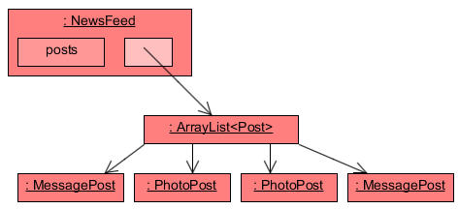
Object diagram
A polymorphic collection
Notes:
NewsFeed object will hold two collections: one for MessagePosts, one for PhotoPosts

Slide 32
Static and dynamic types revisited
The static type is how a variable is declared and what the compiler thinks it is.
The dynamic type is what the object really was created as and how it is stored in memory.
Static types can either be interfaces or superclasses!
private static Course oopda = new Course("OOPDA", "This course teaches advaned Java.");
private static Section oopda01 = new Section(oopda, 1, "MW 17:00 Robinson 325");
private static Enrollable oopda02 = new Section(oopda, 1, "MW 12:30 Robinson 312");
private Post myNewPost = new PhotoPost("Kevin Brown", "pet.png", "My dog Fido");
private Item corvette = new BigRedItem("1967 Red Corvette");
Static types
Dynamic types

Slide 33
Inheritance – Part 2 (for discussion in-class)

Slide 34
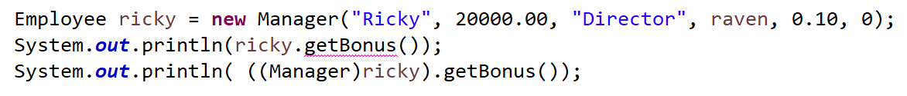
Casting
compilation errors
Static type is a subclass
Works the same way as when the static type was an interface

Slide 35
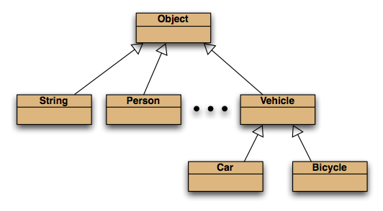
The Object class
All classes inherit from Object.

Slide 36
Wrapper classes
Primitive types (int, char, etc) are not objects. They must be wrapped into an object to be in a collection
Wrapper classes exist for all simple types:
int i = 18;
Integer iwrap = new Integer(i);
…
int value = iwrap.intValue(); int j = iwrap;
Integer jwrap = i;
simple type wrapper class
int Integer
float Float
char Character
... ...
In practice, autoboxing and unboxing mean we don't often have to do this.

Slide 37
Polymorphism and Dynamic Binding
If the object of the subclass has overridden a method in the superclass:
If the variable makes a call to that method, the subclass’s version of the method will be run.
GradedActivity exam = new PassFailActivity(60);
exam.setScore(70);
System.out.println(exam.getGrade());
Java performs dynamic binding or late binding when a variable contains a polymorphic reference.
The Java Virtual Machine determines at runtime which method to call, depending on the type of object that the variable references.

Slide 38
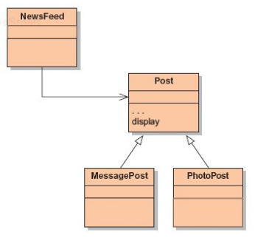
So…getting back to NewsFeed NewsFeed now works at the Post level. This is GOOD!
/**
* Print the news feed details
* to the terminal.
*/
public void show()
{
for(Post post : posts) {
post.display();
// Print an empty line between items
System.out.println();
}
}
}
With inheritance, NewsFeed does not have to duplicate code for MessagePosts and PhotoPosts!
The NewsFeed show() method.

Slide 39
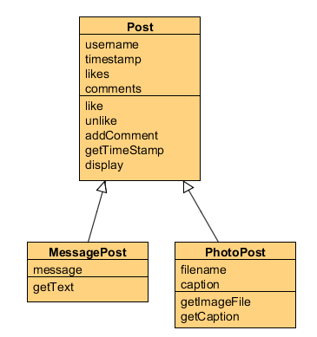
…but this causes a problem
Problem with the display method?
The display method of Post cannot display any subclass fields.
It can only print the common fields.
Inheritance is a one-way street:
A subclass inherits the superclass fields.
The superclass knows nothing about its subclass’s fields.
The superclass has no knowledge at all of any of its subclasses.

Slide 40
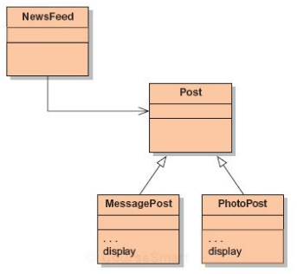
Solution 1: Move display() to the subclasses
The Java compiler performs static type checking
The Java runtime environment performs dynamic type checking.
/**
* Print the news feed details
* to the terminal.
*/
public void show()
{
for(Post post : posts) {
post.display();
// Print an empty line between items
System.out.println();
}
}
}
compilation
runtime
Solution 1 won't compile

Slide 41
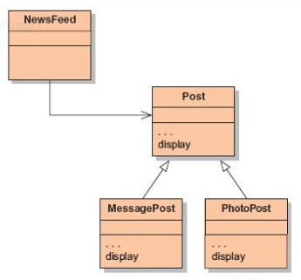
Overriding: the solution
display method in both super- and subclasses.
Satisfies both static and dynamic type checking.

Slide 42
Solution 2: display() in superclass and subclasses
In Post
public void display() {
// This is just a method stub so
// the application will compile.
}
In PhotoPost
public void display() {
System.out.println(username);
System.out.print(
timeString(timestamp));
if (likes > 0) {
System.out.println(" - " + likes + " people like this.");
}
if (comments.isEmpty()) {
System.out.println( " No comments.");
}
else {
System.out.println(" " + comments.size() + " comment(s).");
}
System.out.println(" [" + filename + "]"); System.out.println(" " + caption);
}
In MessagePost
public void display() {
System.out.println(username);
System.out.print(
timeString(timestamp));
if (likes > 0) {
System.out.println(" - " + likes + " people like this.");
}
if (comments.isEmpty()) {
System.out.println( " No comments.");
}
else {
System.out.println(" " + comments.size() + " comment(s).");
}
System.out.println(message);
}
The only unique code!

Slide 43
Solution 2: display() in superclass and subclasses
In Post
public void display() {
// This is just a method stub so
// the application will compile.
}
In PhotoPost
public void display() {
System.out.println(username);
System.out.print(
timeString(timestamp));
if (likes > 0) {
System.out.println(" - " + likes + " people like this.");
}
if (comments.isEmpty()) {
System.out.println( " No comments.");
}
else {
System.out.println(" " + comments.size() + " comment(s).");
}
System.out.println(" [" + filename + "]"); System.out.println(" " + caption);
}
In MessagePost
public void display() {
System.out.println(username);
System.out.print(
timeString(timestamp));
if (likes > 0) {
System.out.println(" - " + likes + " people like this.");
}
if (comments.isEmpty()) {
System.out.println( " No comments.");
}
else {
System.out.println(" " + comments.size() + " comment(s).");
}
System.out.println(message);
}
Access must relax to protected
or
Must use getters

Slide 44
Solution 2 works, but…
Emily Johnson
0 seconds ago
No comments.
[photo1.jpg]
The Night Market
Emily Johnson
0 seconds ago
No comments.
[photo2.jpg]
Buddhist Temple
Drake Gomez
0 seconds ago
No comments.
The Bangkok shopping district is amazing!
Drake Gomez
0 seconds ago
No comments.
[photo17.jpg]
An elephant walking in the middle of the city
Susan Bay
0 seconds ago
No comments.
I want to attend the Songkran festival.
Violated the DRY principle
You've repeated code.
Violated Open-Closed Principle (Classes should be open for extension, but closed for modification)
The subclasses PhotoPost and MessagePost will have to change if you decided to change how the timestamp looks
These classes NOT closed for modification.
You haven't encapsulated well.
If you had, anything specific to Post display would have been in the Post class.

Slide 45
Solution 3: display() in superclass and subclasses
In Post
public void display() {
System.out.println(username);
System.out.print(
timeString(timestamp));
if (likes > 0) {
System.out.println(" - " + likes + " people like this.");
}
if (comments.isEmpty()) {
System.out.println( " No comments.");
}
else {
System.out.println(" " + comments.size() + " comment(s).");
}
}
In MessagePost
public void display() {
super.display();
System.out.println(message);
}
In PhotoPost
public void display() {
super.display();
System.out.println(" [" + filename + "]"); System.out.println(" " + caption);
}

Slide 46
Dynamic Run-Time Binding
import javax.swing.JOptionPane;
public class Polymorphism1 {
public static void main(String[] args) {
// Example of late or run-time binding.
Mammal flipper = new Mammal("Flipper");
Horse seabiscuit = new Horse("Seabiscuit");
String whoToFeed = JOptionPane.showInputDialog("HORSE or DOLPHIN?");
if (whoToFeed.equalsIgnoreCase("HORSE"))
feed(seabiscuit);
else
feed(flipper);
}
private static void feed(Mammal myMammal) {
/* But will the object myMammal be a Mammal or a Horse? We won't know until execution time */
System.out.println("\nFeeding a Mammal or any of its subclasses...");
myMammal.eat();
}
}
Polymorphic binding:
It is the object’s type that determines which method is called.
The compiler has no idea what kind of object to expect here.

Slide 47
The Object class’s methods: toString() and equals()
Methods in Object are inherited by all classes.
Any of these may be overridden.
The toString method is commonly overridden:
public String toString()
Returns a string representation of the object.
This can (and generally should) be overriden
.equals()
Compare the use of == with .equals()
Default .equals() method from class Object is similar to == and thus should be overridden
Consier this overriding in a Student class
public boolean equals(Object obj)
{
if (this == obj)
return true;
if (!(obj instanceof Student))
return false;
Student other = (Student) obj;
return name.equals(other.name) &&
id.equals(other.id) &&
credits == other.credits;
}

Slide 48
Overriding hashCode in Student Override to match .equals()
/**
* Hashcode technique taken from
* Effective Java by Joshua Bloch.
*/
public int hashCode()
{
int result = 17;
result = 37 * result + name.hashCode();
result = 37 * result + id.hashCode();
result = 37 * result + credits;
return result;
}

Slide 49
Abstract classes

Slide 50
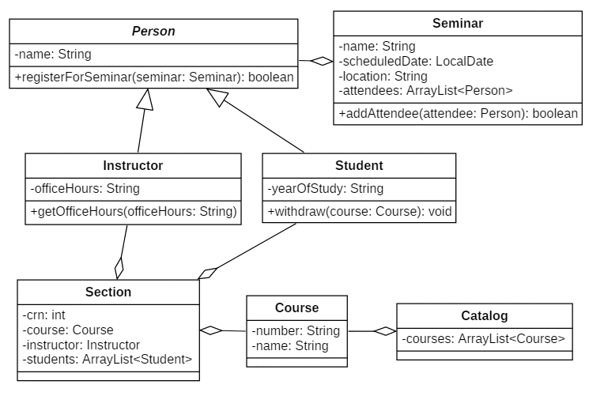

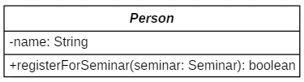
Abstract Classes
An abstract class cannot be instantiated, but other classes are derived from it.
An Abstract class serves as a superclass for other classes.
The abstract class represents the generic or abstract form of all the classes that are derived from it.
A class becomes abstract when you place the abstract key word in the class definition.
public abstract class Person
In UML, the name of an abstract class is italicized.

Slide 51
Methods in Abstract Classes
Concrete methods
What we are used to – methods with a body
Abstract methods
An abstract method is a method that appears in a superclass, but expects to be overridden in a subclass.
An abstract method has only a header and no body.
Any class that contains an abstract method is automatically abstract.
If a subclass fails to override an abstract method, a compiler error will result.
Abstract methods are used to ensure that a subclass implements the method.
A concrete subclass of an abstract superclass must implement all abstract methods of that superclass, otherwise it will also be abstract
public String getName() {
return this.name;
}
public abstract boolean registerForSeminar(Seminar seminar);
Notice that the key word abstract appears in the header, and that the header ends with a semicolon.

Slide 52
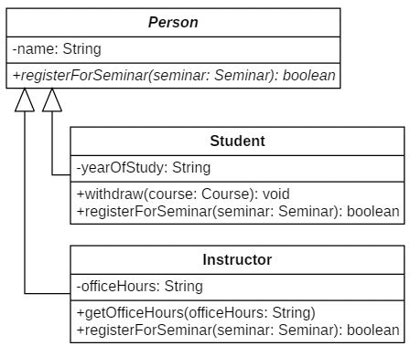
Abstract Methods Force Implementation
@Override
public boolean registerForSeminar(Seminar seminar) {
if (getPermissionFromFaculty(seminar)) {
return seminar.addAttendee(this);
}
else {
return false;
}
}
@Override
public boolean registerForSeminar(Seminar seminar) {
return seminar.addAttendee(this);
}

Slide 53
Two techniques
Make registerForSeminar() abstract in the superclass and force each subclass to implement the body of the method.
Make registerForSeminar() concrete in the superclass and allow each subclass to override it if needed.
Under which circumstances would you choose each technique?

Slide 54
Methods
ABSTRACT CLASSES
Concrete methods
What we are used to – methods with a body
Abstract methods
An abstract method is a method with no body that appears in a superclass, but expects to be overridden in a subclass.
CONCRETE CLASSES
Concrete methods
What we are used to – methods with a body

Slide 55
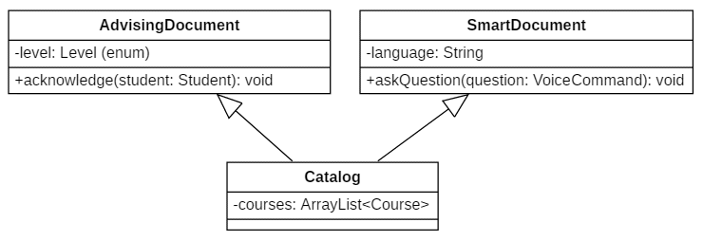
Multiple Inheritance
Many languages support multiple inheritance, such as Eiffel or Python.
Java does not.

Slide 56
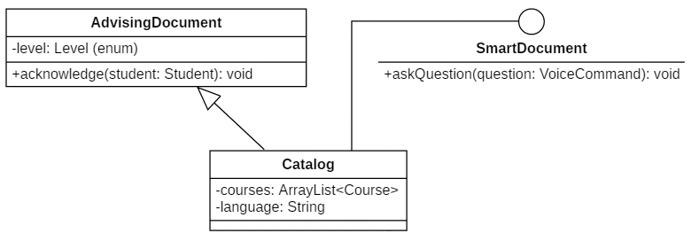
Interfaces Simulate Multiple Inheritance
We can create an interface to accomplish some of this.

Slide 57
Interfaces vs. Abstract Classes
Abstract Class
Can contains abstract and concrete methods
Static constants
Cannot be instantiated
A class cannot inherit from more than one superclass; thus it can only have 1 abstract class parent.
Can contain static methods
Methods may contain code as well as being abstract
Interface
Can contain abstract and default methods
Static constants
Cannot be instantiated
Multiple interfaces can be implemented by a class
Static methods may have a body
Non static methods may have a default body
Any object that implements an interface is marked as that interface type (instance of)

Slide 58
Supplemental Slides

Slide 59
Access Specifiers
Access Modifier | Accessible to a subclass inside the same package? | Accessible to all other classes inside the same package?
default (no modifier) | Yes | Yes
Public | Yes | Yes
Protected | Yes | Yes
Private | No | No
Access Modifier | Accessible to a subclass outside the package? | Accessible to all other classes outside the package?
default (no modifier) | No | No
Public | Yes | Yes
Protected | Yes | No
Private | No | No

Slide 60
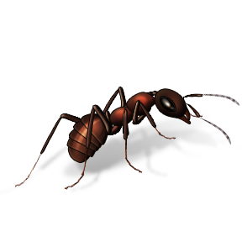
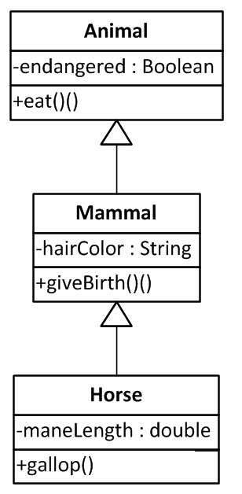
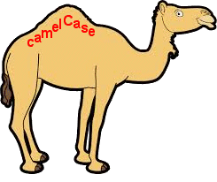
Mammals and Horses

Slide 61
Polymorphism vs. Inheritance (1)
When we declare a reference variable using a particular class name, it can be used to refer to any object of that class.
Horse myHorse = new Horse("Seabiscuit");
myHorse = DerbyWinners.getHorse(2013);
In addition, it can also refer to any object of any class that is related to its declared type by inheritance.
Mammal pet; // reference pet is expecting a Mammal
Horse secretariat = new Horse( );
pet = secretariat; // a valid assignment to a superclass object
pet.eat(); // Assigning a Horse object to an instance of Mammal is safe. // A Horse is-a Mammal; everything the Mammal can do, the Horse can do.
The reverse does not work .
Horse pet; // reference pet is expecting a Horse
Mammal secretariat = new Mammal( );
pet = secretariat; ← Type mismatch: cannot convert from Mammal to Horse

Slide 62
Explanatory Diagram
Mammal pet; // reference pet is expecting a Mammal
Horse secretariat = new Horse( );
pet = secretariat; // a valid assignment to a superclass object
pet.eat(); // Assigning a Horse object to an instance of Mammal is safe. // A Horse is-a Mammal; everything the Mammal can do, the Horse can do.
Horse pet; // reference pet is expecting a Horse
Mammal secretariat = new Mammal( );
pet = secretariat; ← Compile error: Type mismatch: cannot convert from Mammal to Horse
Horse
secretariat
Horse
pet
Mammal
endangered
hairColor
maneLength
eat() giveBirth() gallop()
false
"tan"
5.2
The Mammal variable "pet" successfully points to the Horse object because a Horse IS-A Mammal
What do you mean "I can't gallop??"
Mammal
secretariat
Mammal
endangered
hairColor
eat() giveBirth()
false
pet
Horse
"tan"
Will not work because a Mammal IS-NOT-A Horse
X

Slide 63
Example
Mammal
LandMammal
AquaticMammal
Dolphin
Whale
Giraffe
Rhinocerous

Slide 64
Example
jerry is a land mammal: true
jerry is a mammal: true
but jerry is really a inheritance.Giraffe
...or more simply, really a Giraffe
package inheritance;
public class MammalTester {
public static void main(String[] args) {
Giraffe jerry = new Giraffe();
Whale willy = new Whale();
Rhinocerous ritaxes = new Rhinocerous();
Dolphin flipper = new Dolphin();
LandMammal scoobydoo = new LandMammal();
AquaticMammal moby = new AquaticMammal();
System.out.println("jerry is a land mammal: " + (jerry instanceof LandMammal));
System.out.println("jerry is a mammal: " + (jerry instanceof Mammal));
System.out.println("but jerry is really a " + jerry.getClass().getName());
System.out.println("...or more simply, really a " + jerry.getClass().getSimpleName());

